Slide 1
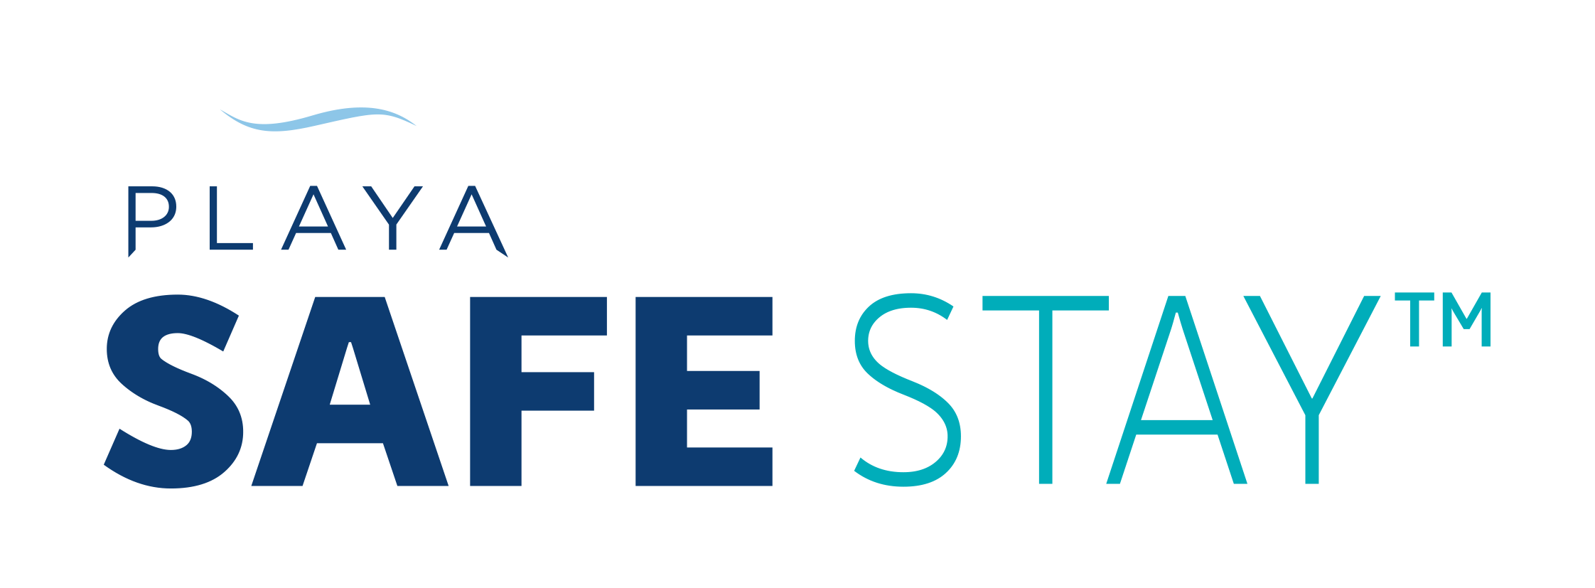
Playa Hotels & Resorts announced the Playa Safe Stay initiative on May 4, 2020. In direct response to the COVID-19 Pandemic and elevated guest expectations, Playa Safe Stay focuses on preventive anti-viral measures, reassuring guests with confidence that only Hyatt or Hilton can deliver and bring key sectors of the travel industry together for solutions.

Slide 2
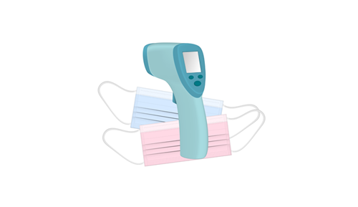
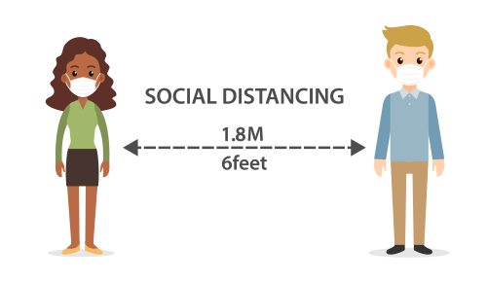
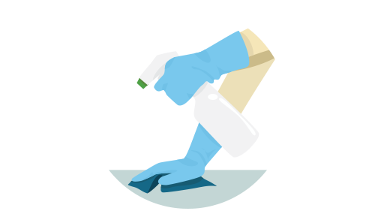
WHAT TO EXPECT EVERYDAY
EMPLOYEE CARE & PERSONAL PROTECTIVE GEAR
Personal Protective gear is standard throughout the resort along with regular health screenings and temperature checks.
SOCIAL DISTANCE STANDARDS
Our associates and guests are observing safe distancing standards at all times.
METHODICAL TREATMENT & CLEANING
High traffic areas and high touch points in common areas are sanitized and cleaned hourly.

Slide 3
WHAT TO EXPECT EVERYDAY
REDESIGNED SEATING AT DINING & ENTERTAIN VENUES
All of our dining venues, common areas, pool decks and any gathering areas have been re-imagined.
LOCAL SERVICES YOU CAN TRUST
All local partners (excursions, private transportation) are required to implement specific measures of cleanliness and antiviral prevention.

Slide 4
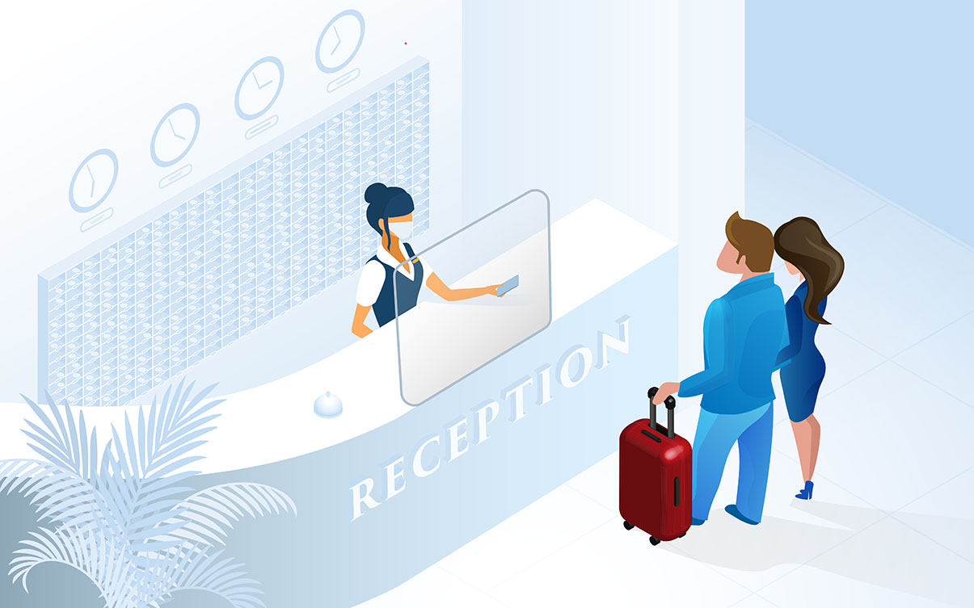
SPECIFICS
SAFE ARRIVALS & SAFE DEPARTURES
Reduced Contact Arrival - Protective glass shields protect guest and associate interactions
Personal Protection Equipment (PPE) – All associates are outfitted with the proper PPE, including face covering and gloves
High-Touch Sanitization – All pens, paper, room keys or any other handled materials are disposed or disinfected after each use
Luggage – Guest luggage is sanitized at arrival and just prior to departure
Transportation - Cars, vans, limousines and golf carts are disinfected frequently during the day and before and after each use
Contactless Farewell - Express checkout and touchless payment methods are available

Slide 5
SPECIFICS
Rest easy in rooms and suites cleaned and sterilized with the most effective anti-viral techniques available. Through our ongoing partnerships with Hyatt and Hilton, along with leading minds in the field of hospitality cleaning and services, we’ve designed robust series of protocols for each guest accommodation type.

Slide 6
SPECIFICS
Deep Cleanings - Furniture, minibars and décor in each room are cleaned and sanitized daily prior to guest arrival. Scheduled cleanings during the length of a guest’s stay can only be requested by the guest in residence.
PPE – On the occasion that any Playa associate enters the guest’s room or suite, appropriate PPE will be worn
Safe Seal - A safe seal indicates when the room was serviced
Contactless Cleaning - Unless requested, strict protocols are in place regarding “no touch” or organization of guests’ belongings
Amenities – Antibacterial gel (hand sanitizer) and disinfectant wipes are included with sealed bathroom amenities. All toiletries are brand-new with each guest and glassware has been replaced with single-use disposable items
Electronics – All electronic items including televisions, in-room tablets and remote controls are safely sanitized. Remote controls will be disinfected and placed in a sealed bag

Slide 7
SPECIFICS
Through partnerships with Hyatt and Hilton, a complete and methodical approach to food & beverage preparation protects our guests while not sacrificing our culinary perfection. All that’s left for you to do is enjoy.

Slide 8
SPECIFICS
Enhanced Sanitization - Strict sanitization processes are in place at all dining venues and hand sanitizer is available at the entrance
Reservations - Tables in dining venues are at least six feet apart and call-ahead seating at à la carte venues limits crowds or queues
Markets (Buffet Dining) – Reimagined approach to buffet dining that includes sealed and protective barriers and staff-assisted service
Digital Menus - Access new digital menus for a true no-touch experience
Bars and Lounges – Surfaces immediately cleaned and sanitized after each service and twice an hour
Takeout – Enhanced takeout service available with sealed containers and disposable wares
Room Service - Room service packaging/delivery adheres to new, improved protocols with each safely sealed

Slide 9
SPECIFICS
As you can see, we’re taking safety precautions seriously, but do you know what else we’re taking seriously? F-u-n! We promise to not only deliver the confidence you need to enjoy a safe, quality vacation, but also, the nonstop excitement and fun you expect.

Slide 10
SPECIFICS
Enhanced Sanitization – Deep cleaning and disinfection of all public spaces—with an emphasis on high touchpoints—is taking place every hour and a half
Social Distancing - Distance of tables, chairs, sunbeds, etc., are at least six feet apart, family to family
Pools - Swimming pools and hot tubs are sterilized regularly. Social distance standards will apply to water slides and lazy rivers
Kids - Kids and teen club equipment is disinfected and sterilized after use or every half hour.
Sports - All sporting goods and water sport equipment is disinfected and sterilized before and after each use
Gym – Fitness centers are redesigned for social distancing, antibacterial wipes are available and gym equipment is being sanitized routinely

Slide 11
In a first for the hospitality business, Hilton will collaborate with RB, maker of Lysol and Dettol, and consult with Mayo Clinic to develop elevated processes and Team Member training to help Hilton guests enjoy an even cleaner and safer stay from check-in to check-out.
Hilton CleanStay with Lysol protection, as the program will be called in North America, will be a rigorous system that incorporates RB’s trusted know-how and scientific approach to cleaning practices and product offerings. Experts from Mayo Clinic’s Infection Prevention and Control team will advise and assist in enhancing Hilton’s cleaning and disinfection protocols.

Slide 12
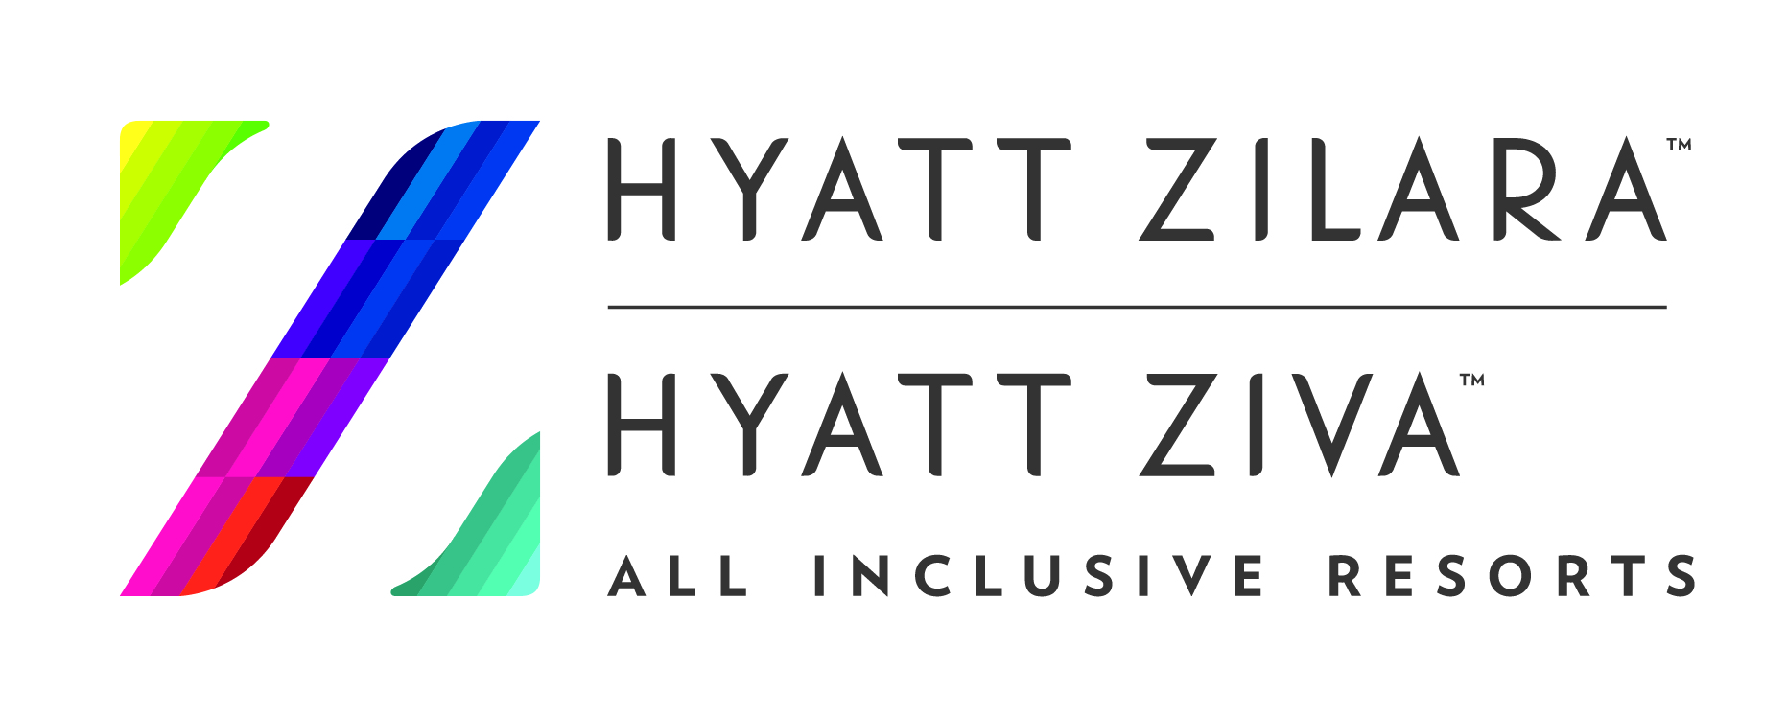
Hyatt Hotels Corporation recently announced a new Global Care & Cleanliness Commitment that includes an accreditation process by the Global Biorisk Advisory Council (GBAC), at all hotels around the world.
The commitment to GBAC STAR Accreditation builds on Hyatt’s existing sanitation protocols to add enhanced staff training and support resources. Hyatt has also engaged a cross-functional working group of medical experts and industry professionals that will contribute to both guest and colleague health and safety.

Slide 13
